Slide 1
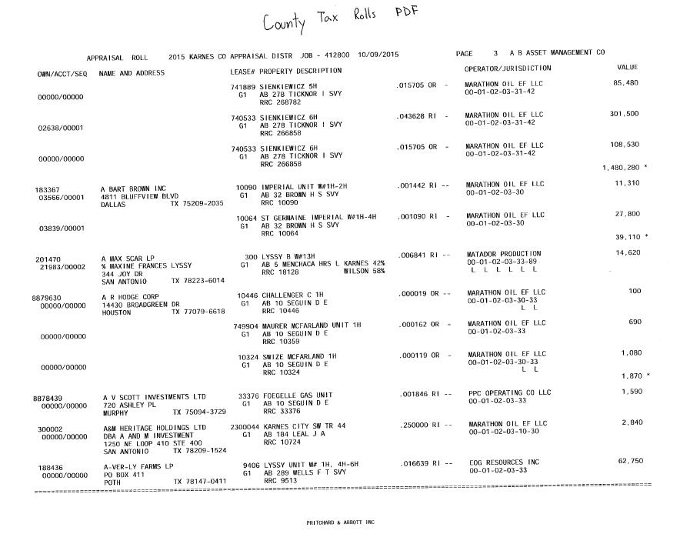
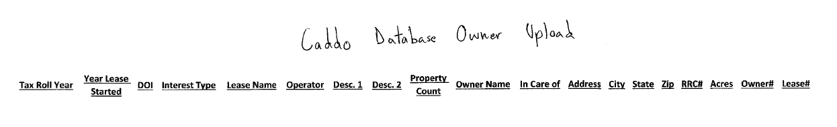
Data Flow
County Tax Rolls (PDF)
County Tax Rolls (Flat Text File to Excel)
County Tax Rolls (Excel) to Caddo Database Template (Excel)

Slide 2

Tax Roll Year
Owner Number
Owner Name
Lease Name
DOI
Int. Type
Operator
1
Owner Address
RRC #
2
Data is sorted by owner. Each Owner can have an interest is multiple leases. In this example. The owner (A Bart brown Inc.) has an interest in 2 different leases.

Slide 3
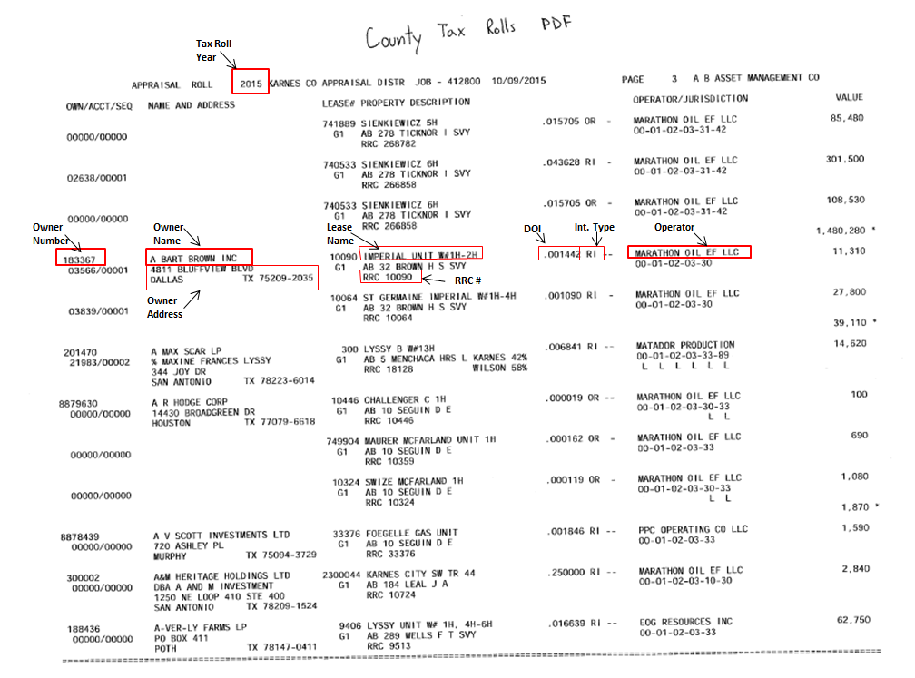
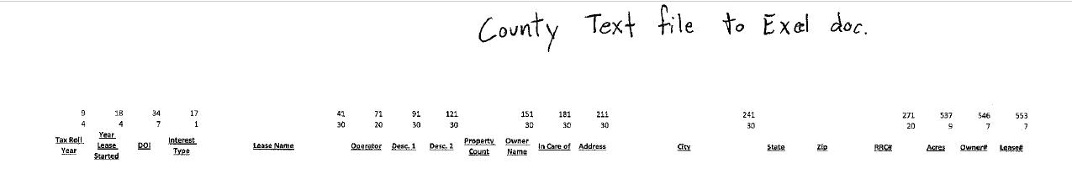
1.
2.

